Slide 1
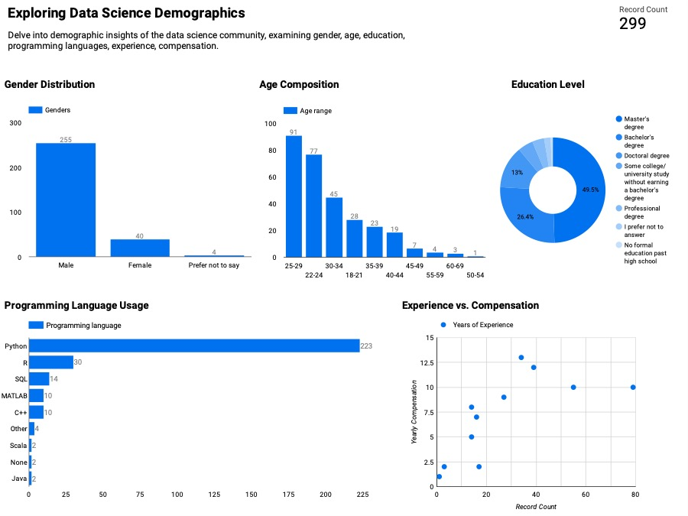
Analyzing the age distribution helps identify the age groups that are most attracted to data science roles. It can inform recruitment strategies and training programs.
I decide to focus on examining gender, age, education, programming languages, experience, compensation of Data Science.
To show the numbers of the respondent.
I choose Gender to be a Bar chart because Understanding the gender distribution in the data science community is essential for promoting diversity and inclusion within the field. It helps organizations identify potential gender disparities.
I Choose the Education level to be a donut chart because Education levels can provide insights into the qualifications of data science professionals. It helps identify whether most data scientists have advanced degrees or come from diverse educational backgrounds.
A bar chart is effective for comparing the usage of multiple programming languages because it displays each language's frequency as a separate bar. This allows easy comparison of language popularity among data scientists.
A scatter plot is used to display the relationship between experience and compensation for each respondent individually. It reveals trends, clusters, and outliers, providing insights into how compensation varies with experience in data science.
Understanding which programming languages are commonly used is crucial for guiding aspiring data scientists on which languages to learn. It also helps organizations make decisions on technology stacks.
The relationship between years of experience and compensation is critical for professionals and organizations alike. It can help identify salary trends in the data science field.

